Slide 1
ECE 212 Lab 2
Khashayar Hashemi

Slide 2
Objectives
Getting familiar with different addressing modes.
Learning to multiply and divide in assembly.
Learning about arithmetic and logical shifting

Slide 3
Lab 2.A
Objective: The goal is to add the values of two arrays of integers and store the results in another memory location.
Procedure:
Fetch the next value (word) from the first array.
Fetch the next value from the second array.
Add the two values.
Store the result in the next memory.
Repeat the above procedure.

Slide 4
How to read the arrays?
Memory location 0x20001004 contains the address of the first array. (0x20001004 itself is not the address of the first array!)
Memory location 0x20001008 contains the address of the second array. (0x20001008 itself is not the address of the second array!)
Therefore, you will have to use “ldr” twice. Once to fetch the address, and another time to get the value

Slide 5
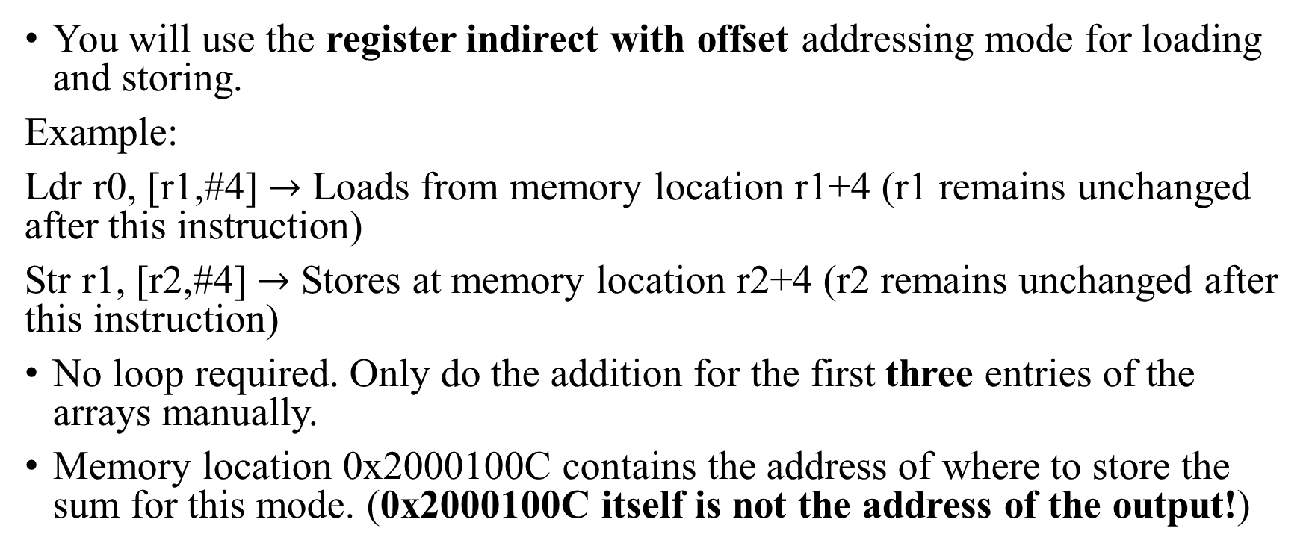
Lab 2.A (Part 1)
You will use the register indirect with offset addressing mode for loading and storing.
Example:
Ldr r0, [r1,#4] $→$ Loads from memory location r1+4 (r1 remains unchanged after this instruction)
Str r1, [r2,#4] $→$ Stores at memory location r2+4 (r2 remains unchanged after this instruction)
No loop required. Only do the addition for the first three entries of the arrays manually.
Memory location 0x2000100C contains the address of where to store the sum for this mode. (0x2000100C itself is not the address of the output!)

Slide 6
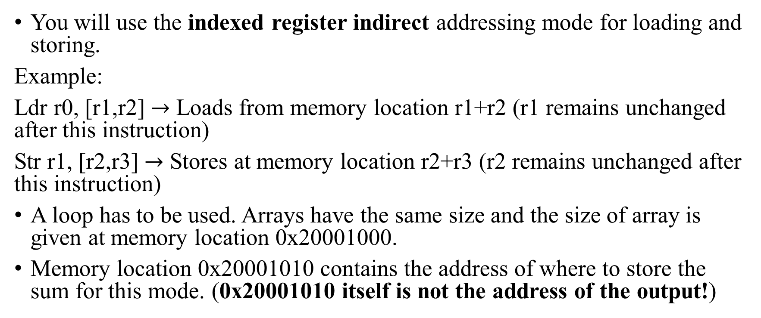
Lab 2.A (Part 2)
You will use the indexed register indirect addressing mode for loading and storing.
Example:
Ldr r0, [r1,r2] $→$ Loads from memory location r1+r2 (r1 remains unchanged after this instruction)
Str r1, [r2,r3] $→$ Stores at memory location r2+r3 (r2 remains unchanged after this instruction)
A loop has to be used. Arrays have the same size and the size of array is given at memory location 0x20001000.
Memory location 0x20001010 contains the address of where to store the sum for this mode. (0x20001010 itself is not the address of the output!)

Slide 7
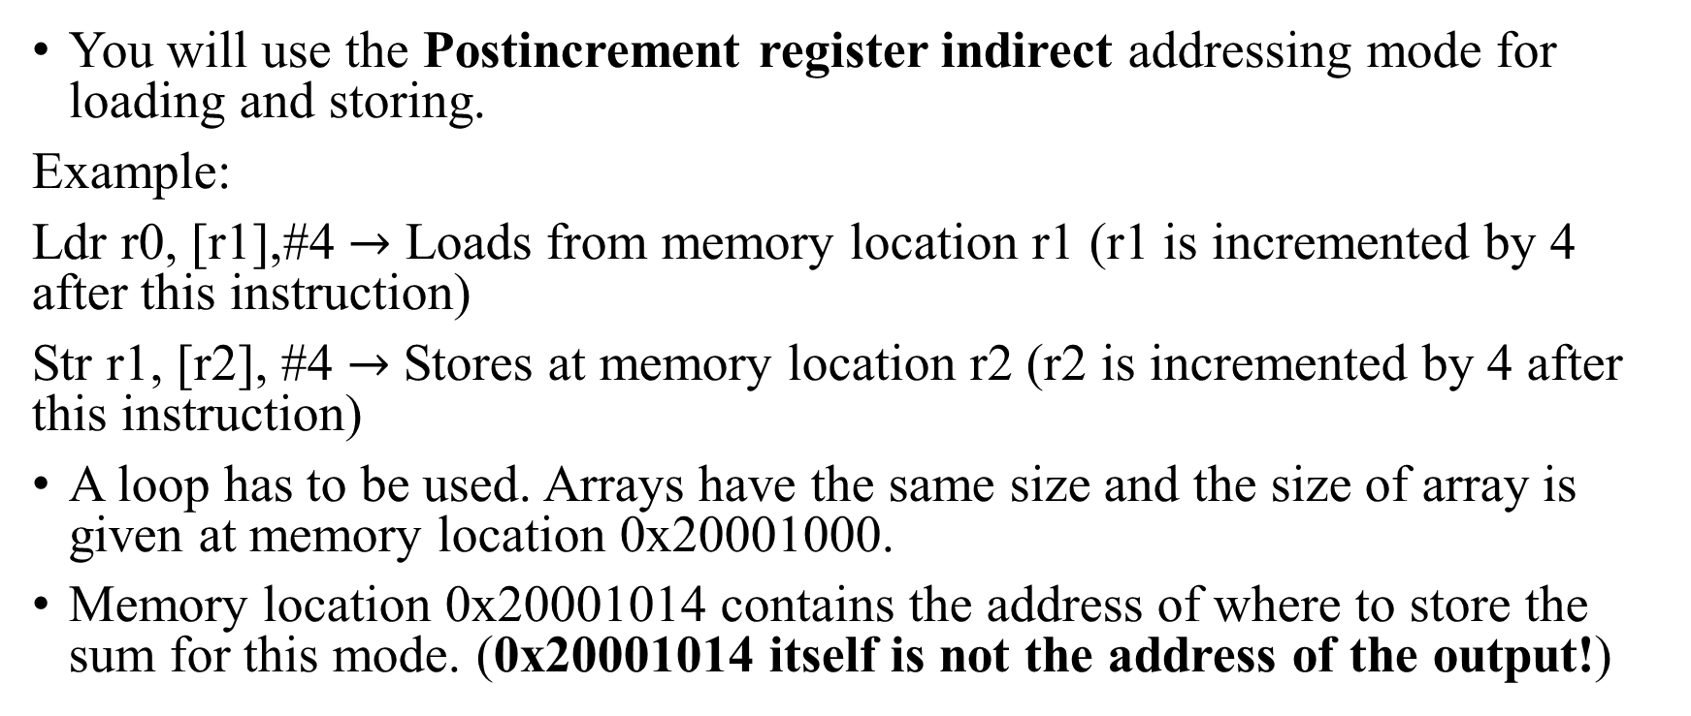
Lab 2.A (Part 3)
You will use the Postincrement register indirect addressing mode for loading and storing.
Example:
Ldr r0, [r1],#4 $→$ Loads from memory location r1 (r1 is incremented by 4 after this instruction)
Str r1, [r2], #4 $→$ Stores at memory location r2 (r2 is incremented by 4 after this instruction)
A loop has to be used. Arrays have the same size and the size of array is given at memory location 0x20001000.
Memory location 0x20001014 contains the address of where to store the sum for this mode. (0x20001014 itself is not the address of the output!)

Slide 8
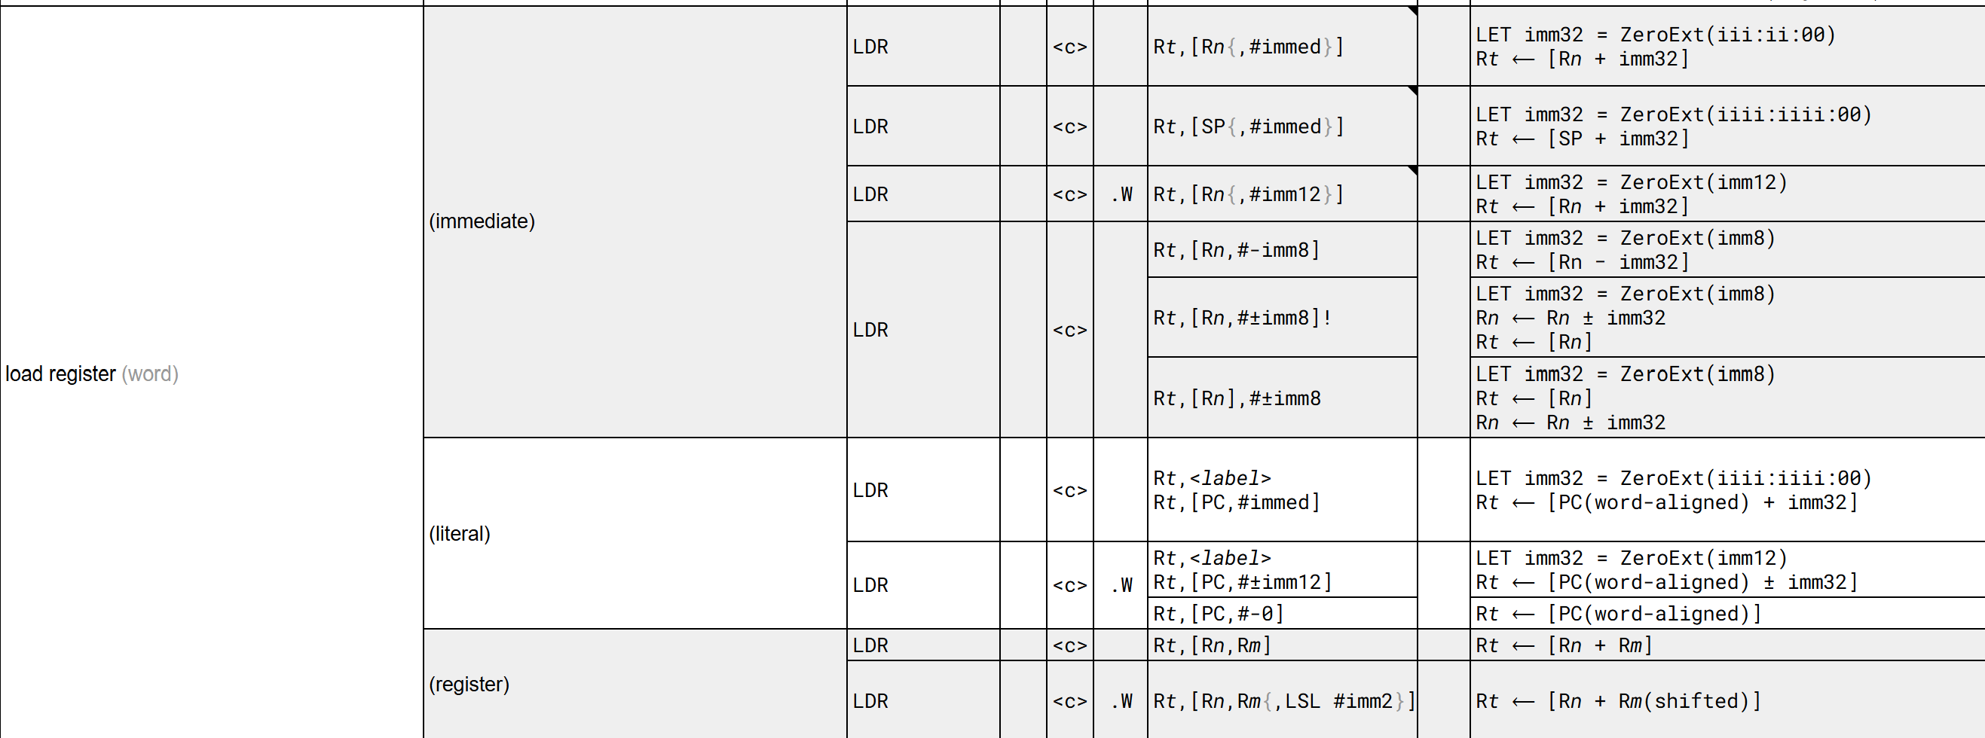

ARMv7-M PQR $→$ Opcode Reference
Part 1
Part 3
Part 2

Slide 9
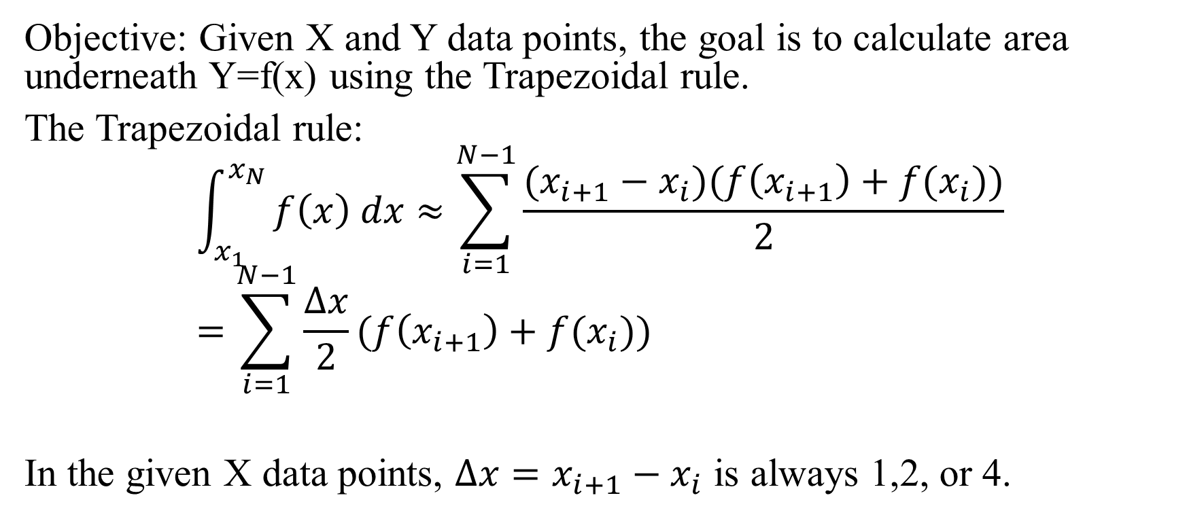
Lab 2.B
Objective: Given X and Y data points, the goal is to calculate area underneath Y=f(x) using the Trapezoidal rule.
The Trapezoidal rule:
$$\int_{x_{1}}^{x_{N}}{f\left(x\right) dx≈\sum_{i=1}^{N−1}{\frac{(x_{i+1}−x_{i})(f\left(x_{i+1}\right)+f(x_{i}))}{2}}}=\sum_{i=1}^{N−1}{\frac{Δx}{2}(f\left(x_{i+1}\right)+f(x_{i}))}$$
In the given X data points, $Δx=x_{i+1}−x_{i}$ is always 1,2, or 4.

Slide 10
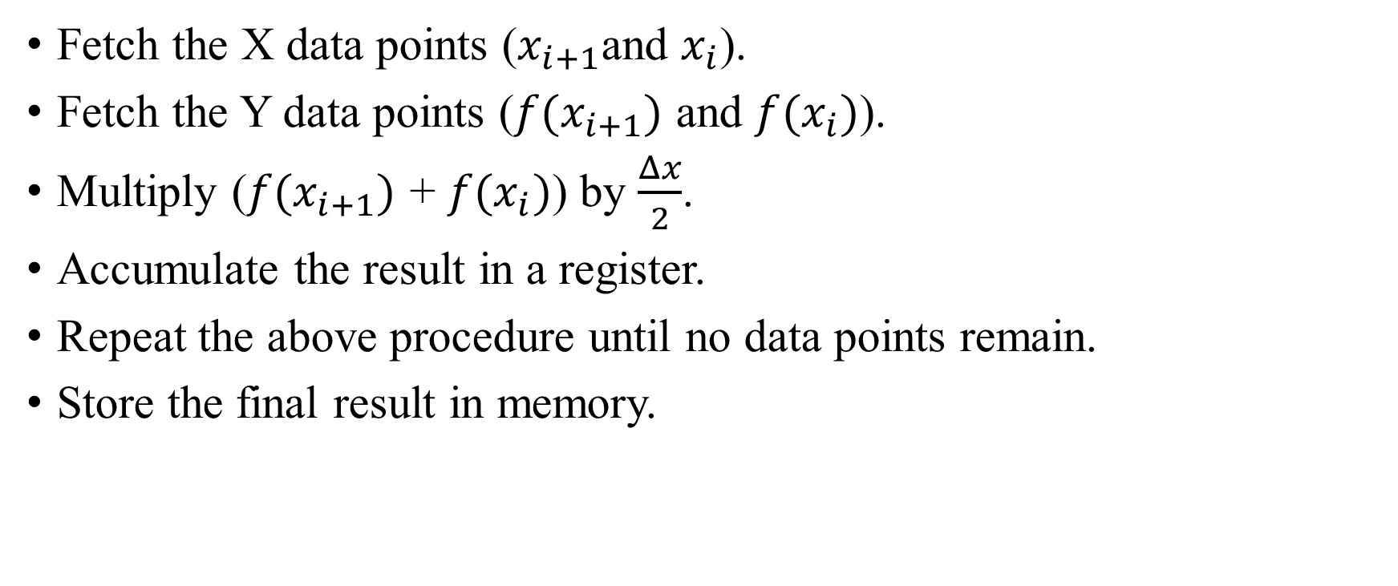
Overall Procedure
Fetch the X data points ($x_{i+1}$and $x_{i}$).
Fetch the Y data points ($f(x_{i+1})$ and $f(x_{i})$).
Multiply ($f(x_{i+1})$ + $f(x_{i})$) by $\frac{Δx}{2}$.
Accumulate the result in a register.
Repeat the above procedure until no data points remain.
Store the final result in memory.

Slide 11
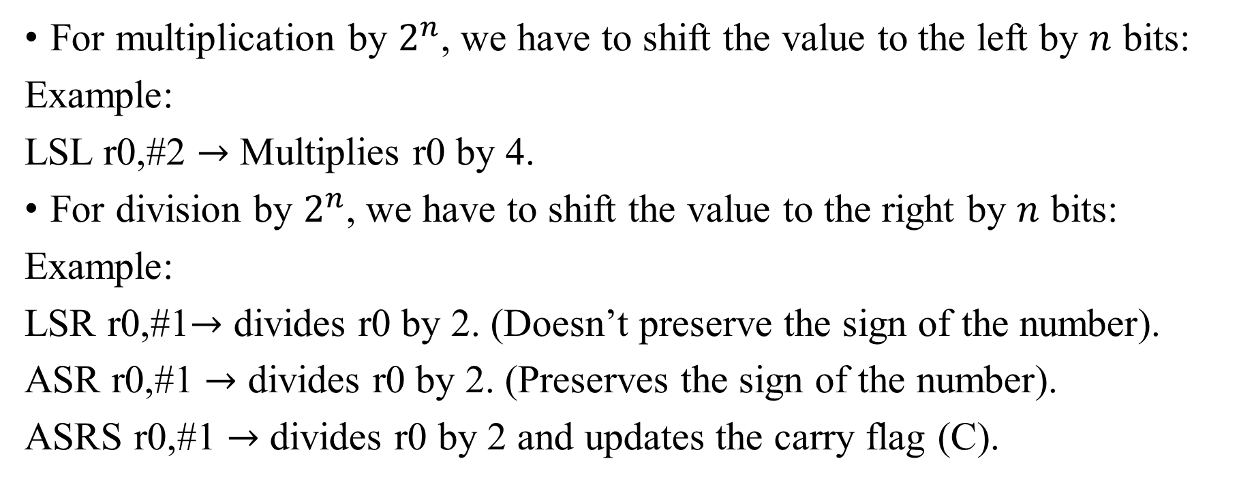
Multiplication and Division
For multiplication by $2^{n}$, we have to shift the value to the left by $n$ bits:
Example:
LSL r0,#2 $→$ Multiplies r0 by 4.
For division by $2^{n}$, we have to shift the value to the right by $n$ bits:
Example:
LSR r0,#1$→$ divides r0 by 2. (Doesn’t preserve the sign of the number).
ASR r0,#1 $→$ divides r0 by 2. (Preserves the sign of the number).
ASRS r0,#1 $→$ divides r0 by 2 and updates the carry flag (C).

Slide 12
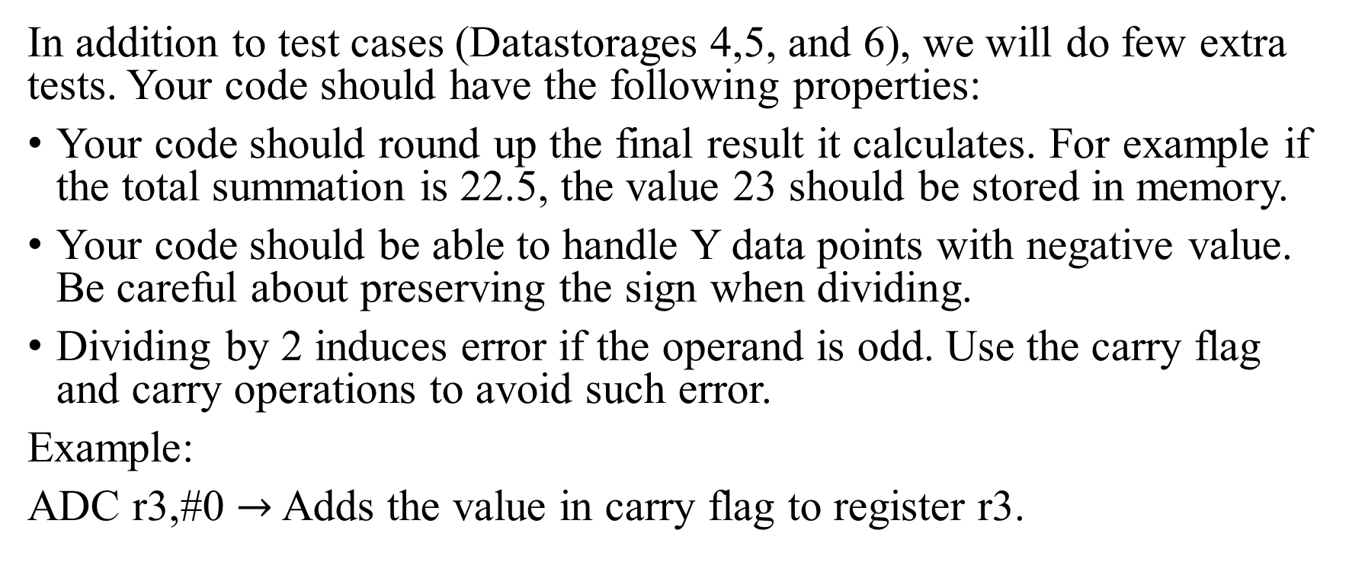
Important!!!
In addition to test cases (Datastorages 4,5, and 6), we will do few extra tests. Your code should have the following properties:
Your code should round up the final result it calculates. For example if the total summation is 22.5, the value 23 should be stored in memory.
Your code should be able to handle Y data points with negative value. Be careful about preserving the sign when dividing.
Dividing by 2 induces error if the operand is odd. Use the carry flag and carry operations to avoid such error.
Example:
ADC r3,#0 $→$ Adds the value in carry flag to register r3.

Slide 13
Quick Notes
This presentation is available on canvas, you can use it along with the manual.
You can demo this week or next week during your session without any deduction.
If you don’t manage to finish by the end of your session next week, you can still do your demo in another session of the lab but there will be a 2 mark deduction per day.

